Slide 1



REVENUE LEAKAGE DETECTION ANALYSIS
Finsecure Technologies
Identifying revenue losses, uncovering root causes, and driving data-backed growth decisions
Presented By:
Akinlade Opeyemi

Slide 2


INTRODUCTION
FinSecure Technologies is a financial technology (SaaS) company that provides digital payment and subscription-based solutions to customers.
The company earns revenue through:
Monthly subscription plans
Paid features and add-ons
Long-term customer contracts
.
“Why are we losing revenue we should have earned?”

Slide 3

PROJECT OBJECTIVES
Goal of the Analysis
The purpose of this project is to:
Identify where revenue is being lost
Understand why it is happening
Recommend actions that can recover lost revenue
Improve long-term profitability

Slide 4
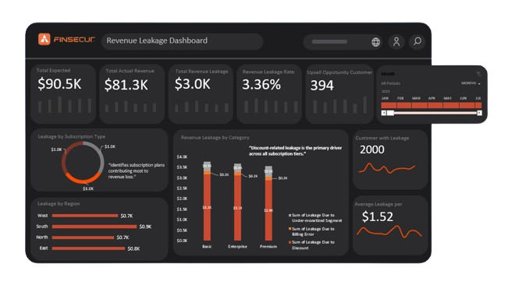

Revenue Leakage Dashboard
What is happening?
FinSecure is losing 3.36% of its expected revenue due to operational and customer-related issues.
.
Expected Revenue
What the company planned to earn based on subscriptions.
Actual Revenue
What the company actually received.
Upsell Opportunity Customers
Customers who:
Are active
Can afford higher plans
Are good candidates for upgrades
(Upsell = encouraging customers to move to a higher-value plan.)

Slide 5

Revenue Leakage Insight
What does the data reveal?
Revenue leakage occurs across all subscription tiers (Basic, Enterprise, Premium), indicating a systemic issue rather than a plan-specific problem.
Discount-related leakage is the primary driver, contributing the largest share of revenue loss across every subscription plan
(e.g., Basic plan discount leakage ≈ $3.2K).
Leakage impacts the entire customer base, with all 2,000 customers affected and an average loss of $1.52 per customer, which becomes material at scale.
Leakage is distributed across all regions, confirming the issue is company-wide and linked to internal pricing, billing, and usage processes rather than geography

Slide 6
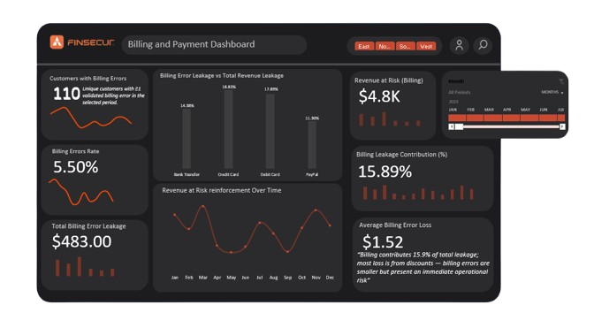
Billing and Payment Dashboard
What is happening?
Billing and payment errors are causing immediate revenue loss and cash-flow risk.
.
Billing Contribution Insight
Billing errors contribute 15.9% of total revenue leakage.
Majority of leakage comes from discounts
But billing errors are more urgent, because:
They create immediate operational and cash-flow risks

Slide 7
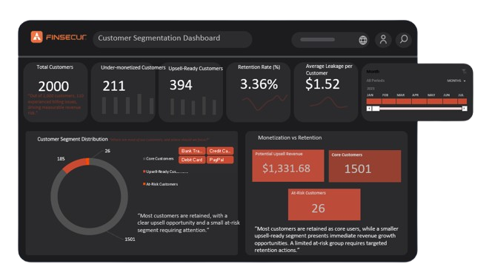
Customer Segmentation Dashboard
What is Customer Segmentation?
Customer segmentation means grouping customers based on:
How much value they bring
How long they stay
How well they use paid features
.
  Insight
  Most customers are retained, with a strong upsell opportunity and a small at-risk segment requiring targeted attention.

Slide 8
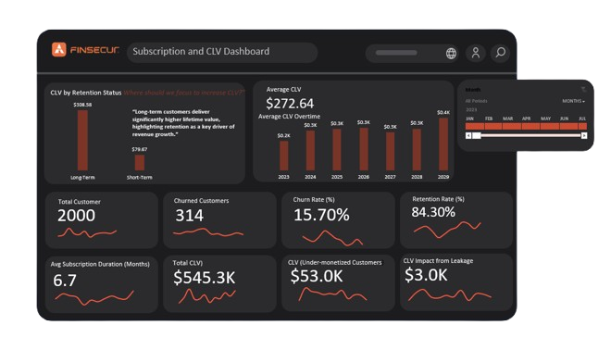
Subscription and CLV Dashboard
What is Subscription & CLV?
🔹 Subscription
How long customers stay active.
🔹 CLV (Customer Lifetime Value)
Total revenue a customer generates over their entire relationship with the company.
What the data is telling us:
Long-term customers generate nearly 4× more lifetime value than short-term customers
(Average CLV: $308.58 vs $79.67).
Although FinSecure has a strong overall retention rate (84.3%), customer churn still impacts revenue:
  314 customers have churned
  15.7% churn rate represents lost future value.
The average subscription duration of 6.7 months indicates that many customers do not remain active long enough to reach their full revenue potential.
With a total CLV of $545.3K, even small improvements in retention duration can create significant long-term revenue uplift

Slide 9
What Should We Do Next
Actionable Recommendations
Billing Process Improvements
Pricing & Discount Optimization
Automate billing validation
Reduce manual billing errors
Monitor high-risk payment periods
Review discount approval rules
Limit excessive discounts
Align discounts with customer lifetime value
Monetization Strategy
Retention Strategy
Target upsell-ready customers with upgrade campaigns
Introduce feature-based pricing tiers
Focus retention efforts on short-term users
Incentivize long-term subscriptions
Reduce churn through loyalty programs

Slide 10
CONCLUSION
By addressing:
Discount leakage
Billing inefficiencies
Under-monetized customers
FinSecure Technologies can:
Recover lost revenue
Improve cash flow
Increase customer lifetime value
Build a more sustainable revenue model
.
  .

Slide 11
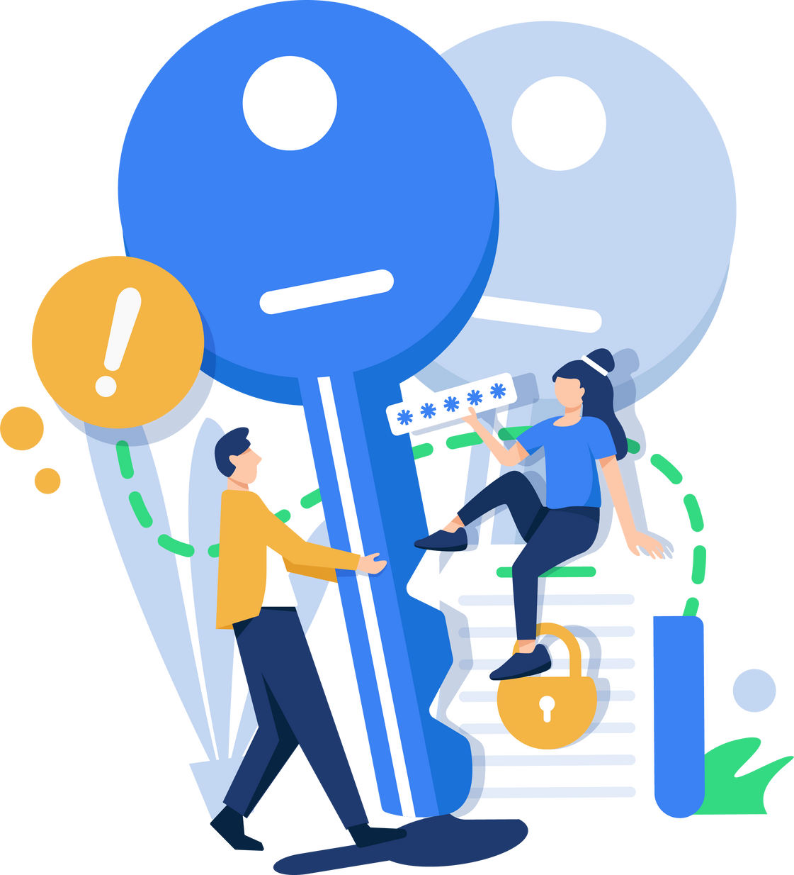
THANK YOU

